Slide 1




Handle
with Care
An initiative to support vulnerable children through simple communication, and partnerships between law enforcement and educators

Slide 2

What is Handle with Care?
Response to a traumatic event involving a child
Law enforcement notifies specific school contact
Designated school contact sends out alert to necessary school personnel (no details) to enable implementation of appropriate supports for that child

Slide 3




Why do this?
Less trauma for the child
ACE (Adverse Childhood Experience): long-term effects of childhood trauma are proven
PCE (Positive Childhood Experience): experiences in childhood that build a child’s sense of belonging and connection can limit the long-term effects of ACE’s

Slide 4



Ensuring Safety
Ensure Scene Safety
Maintain Officer Safety
Manage suspect, victim, and child interaction

Slide 5


When to Send a HWC
Message
Anytime a child is present on a call!
Death of someone in the
household
Arrest of household member
Incident of domestic violence
Search warrant served in residence
Physical or sexual abuse
Drug/alcohol overdose of someone
in household
Community violence

Slide 6




Sending the HWC Message
Agency protocol to send “Handle with Care” message
Message can be sent via email, phone call/text, or 911 dispatch
Message will be sent to the HWC school contact
(Name) (Age)- Handle with Care

Slide 7

60% of U.S. children have been exposed to violence, crime, or abuse.
These children still have to go to class, carrying a burden of stress/trauma that can interfere with their behavior/grades in schools that aren’t even aware there’s an issue.

Slide 8



Before Handle with Care
Taking Away Recess- Can negatively impact students who need movement to self-regulate.
After Handle with Care
Acknowledge emotions: “I see you’re upset. Let’s find a way to fix this together.” Offer space if needed: “Let’s take a break and step outside for a moment.”

Slide 9


Before Handle with Care
Sending to the Principal- May reinforce avoidance behavior rather than addressing the root issue.
After Handle with Care
Wake gently with kindness- Assess well-being calmly and without judgement.

Slide 10


Before Handle with Care
Staying After School- Works for accountability but may not teach self-regulation.
After Handle with Care
Have a one-on-one discussion with the student about their behavior and how it impacted others.

Slide 11

Research shows that children who experience trauma are significantly more likely to face school discipline. Each additional Adverse Childhood Experience (ACE) increases a preschooler’s risk of suspension or expulsion by 80%, and children with four or more ACEs are 32 times more likely to be labeled with behavioral issues. Before programs like Handle With Care, many students were punished for trauma-driven distress rather than supported with understanding.

Slide 12
“Before Handle with Care, we often mistook a child’s bad day for misbehavior. Now, we respond with empathy, reducing disciplinary issues and fostering a more supportive classroom.”
“As a substitute teacher, I often mistook distress for misconduct. Before Handle with Care, I lacked the context to truly support my students. “
“As the Handle with Care contact, I’ve seen how awareness transforms support. This program fosters understanding and creates a safer school environment.”

Slide 13
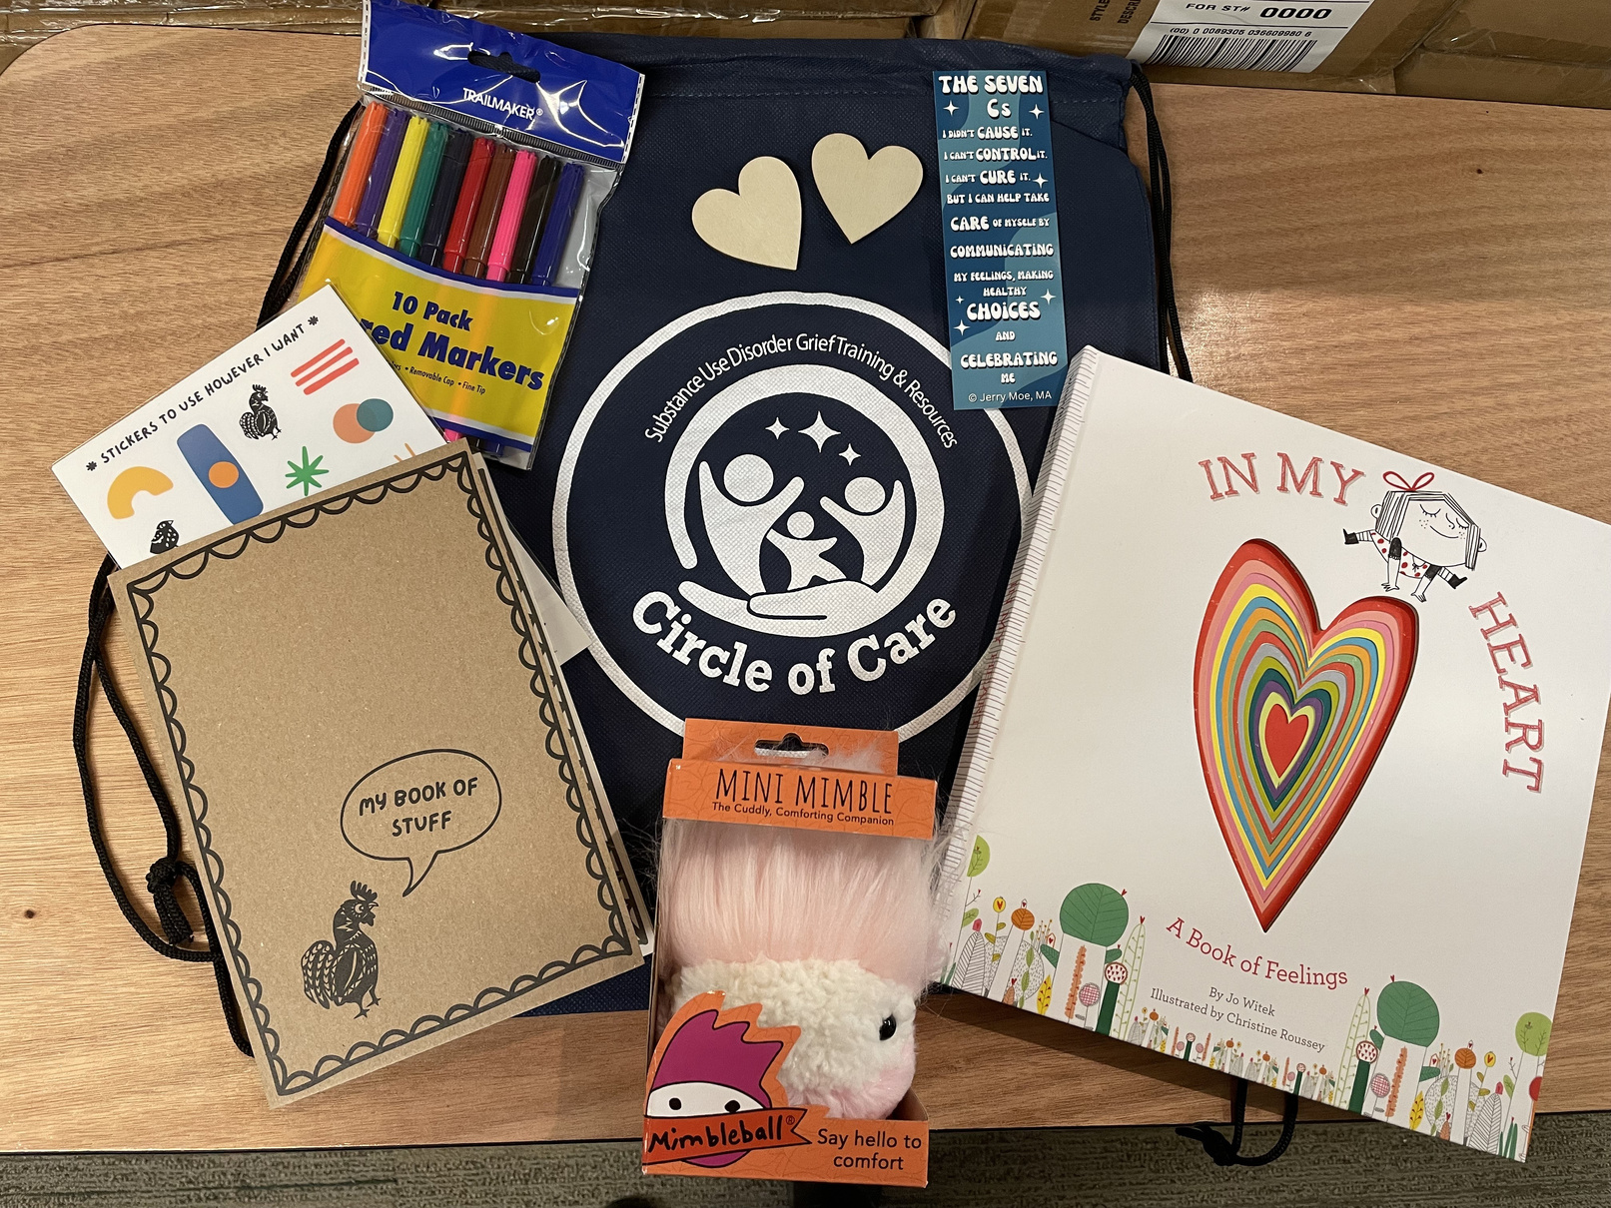
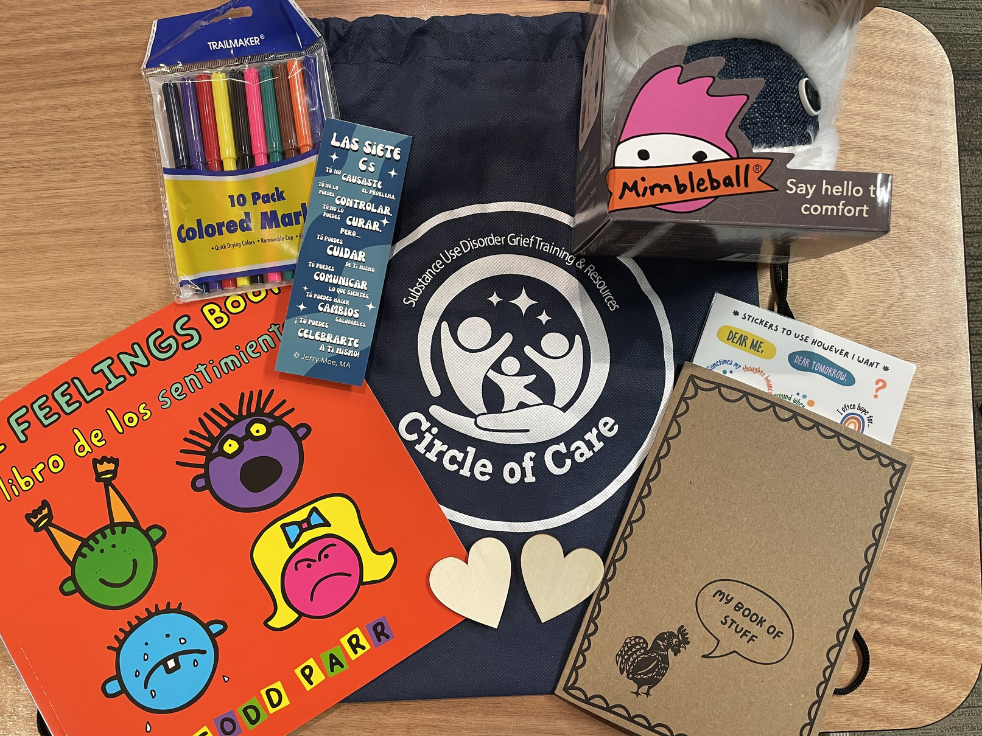
Comfort Bags for Kids
YOUTH ENGLISH BAG
YOUTH SPANISH BAG

Slide 14
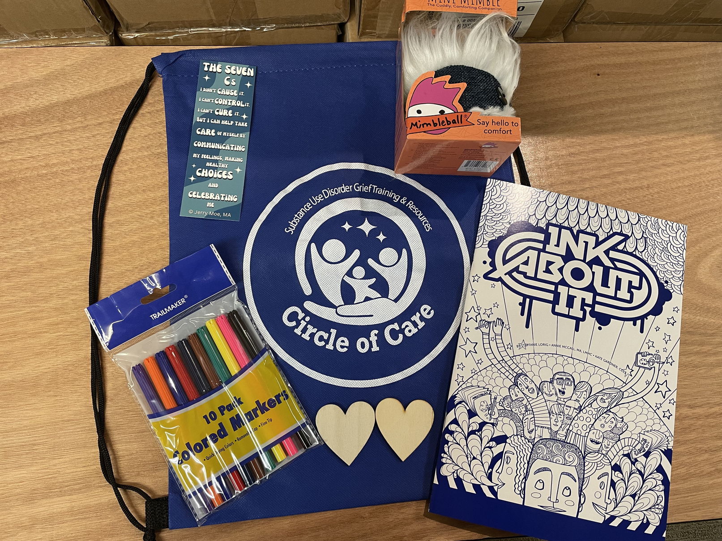
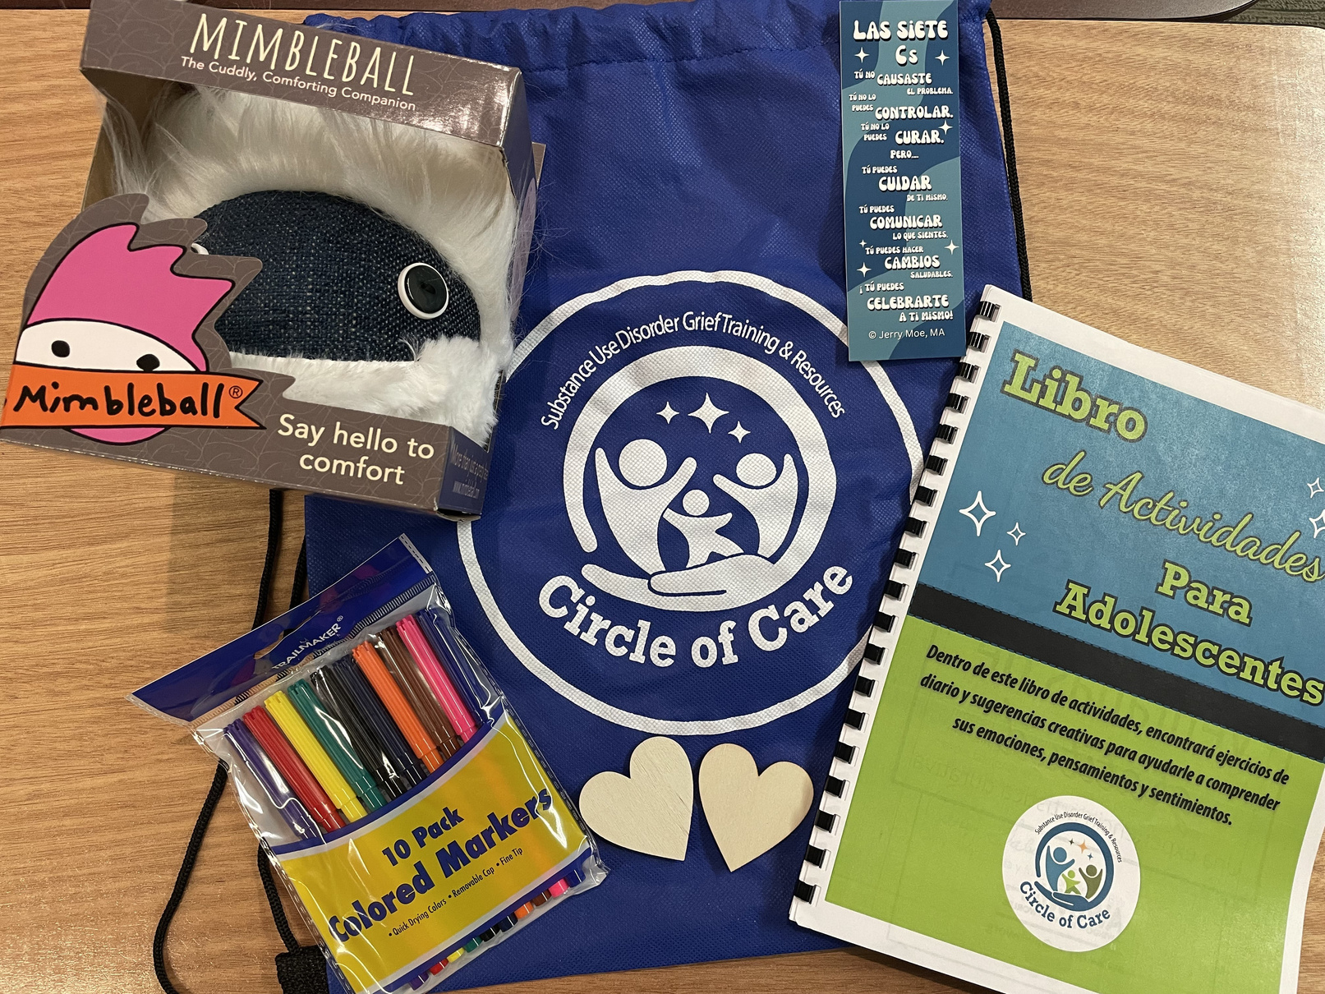
Comfort Bags for Kids
TEEN ENGLISH BAG
TEEN SPANISH BAG

Slide 15
Let’s Talk Basics
URBAN
RURAL

Slide 16
Who To Involve?
Law Enforcement
(police and sheriff offices)
School
(all staff/SRO)
Others?
(DCFS/counseling/medical)

Slide 17



Handle with Care is expanding statewide, mentoring schools and law enforcement to launch their own programs. Interested communities can connect with Circle of Care and SIU for guidance and support.

Slide 18
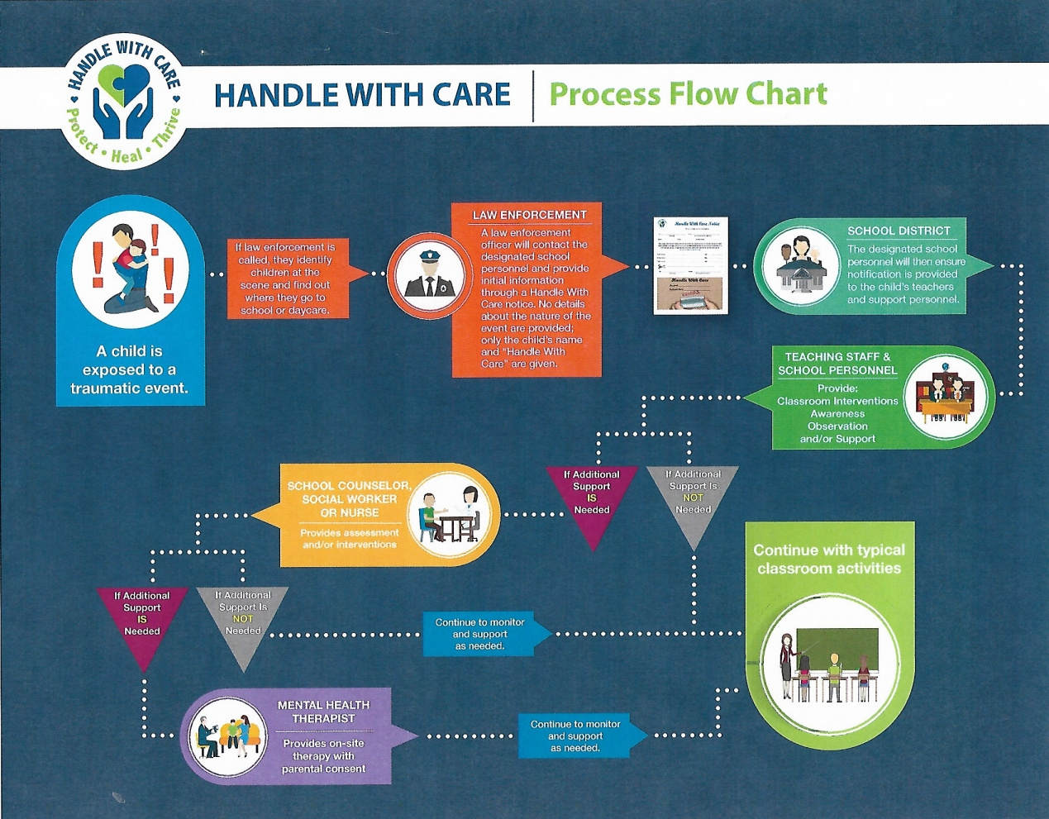

Slide 19
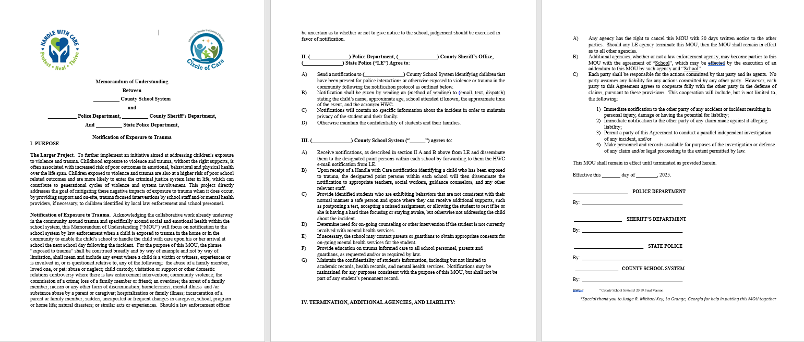

Slide 20
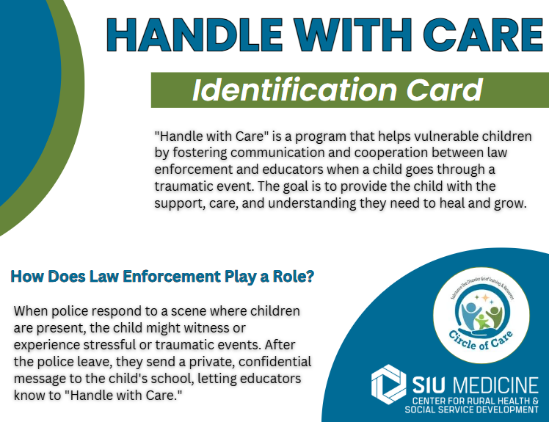
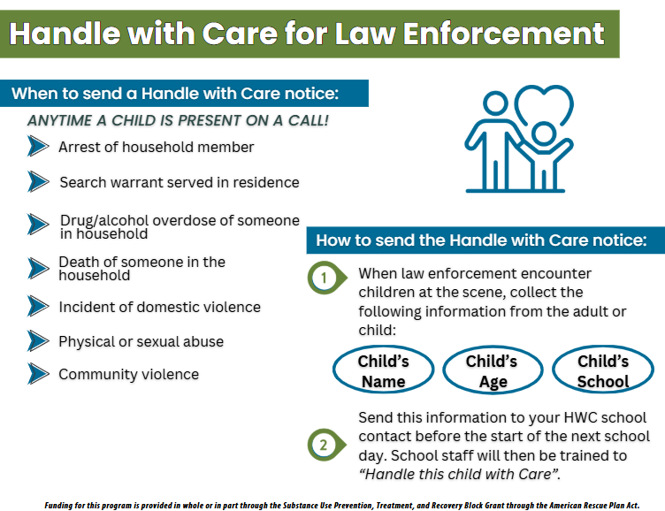

Slide 21



Evaluation
Please scan and fill out the form to:
Evaluate our presentation
Get Handle with Care implementation
materials
Request Comfort Bags for Kids

Slide 22
Questions?
Doug Cochran
Kansas Police Department/
Handle with Care Liaison
217-712-0172
kpddcochran22@gmail.com
Liesl Wingert
Program Coordinator- Eastern Region SIU School of Medicine Center for Rural Health and Social Service Development
618-843-4487
lwingert68@siumed.edu
Teri Moore, MBA
Circle of Care Program Planner
217-254-4826
terim@hourhouserecovery.org
Funding for this program is provided in whole or in part through the Substance Use Prevention, Treatment, and Recovery Block Grant through the American Rescue Plan Act.

